Slide 1
O3BNN-R vs Our Work
2016124103 박상준

Slide 2
O3BNN-R
O3BNN-R: An Out-of-Order Architecture for High-Performance and Regularized BNN Inference
IEEE TRANSACTIONS ON PARALLEL AND DISTRIBUTED SYSTEMS, VOL. 32, NO. 1, JANUARY 2021

Slide 3

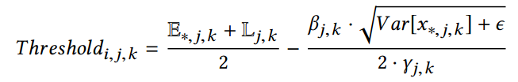
O3BNN-R
Batch Normalization as Threshold
Batch-Normalization functions (BN) in most BNNs can be simplified to a threshold-based compare operation thus avoiding the floating-point calculation
the expensive FP operations in BN now become a simple threshold comparison

Slide 4
O3BNN-R
Batch Normalization as Threshold
Reference : FINN: A Framework for Fast, Scalable Binarized Neural Network Inference
Yaman Umuroglu, Nicholas J Fraser, Giulio Gambardella, Michaela Blott, Philip Leong, Magnus Jahre, and Kees Vissers. 2017
4.2.2 Batchnorm-activation as Threshold

Slide 5

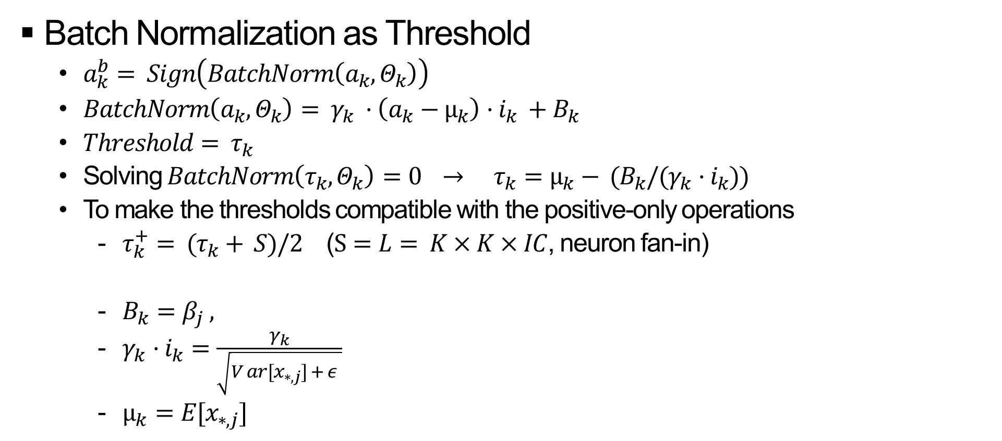

O3BNN-R
Batch Normalization as Threshold
$a_{k}^{b}= Sign\left(BatchNorm\left(a_{k}, Θ_{k}\right)\right)$
$BatchNorm\left(a_{k}, Θ_{k}\right)= γ_{k} ·\left(a_{k}−µ_{k}\right)·i_{k} +B_{k}$
$Threshold= τ_{k}$
Solving $BatchNorm\left(τ_{k}, Θ_{k}\right)=0 → τ_{k}=µ_{k}− (B_{k}/(γ_{k}·i_{k}))$
To make the thresholds compatible with the positive-only operations
$τ_{k}^{+}= (τ_{k}+ S)/2$ ($S=L= K×K×IC$, neuron fan-in)
$B_{k}=β_{j} ,$
$γ_{k}·i_{k}=\frac{γ_{k}}{\sqrt{V ar[x_{∗,j}] + ε }}$
$µ_{k}=E[x_{∗,j}]$
$$τ_{k}^{+}={(µ}_{k}− \left(\frac{B_{k}}{γ_{k}·i_{k}}\right)+S)/2$$
Batch normalization in O3BNN

Slide 6
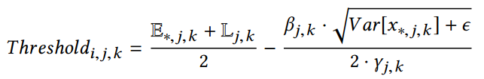

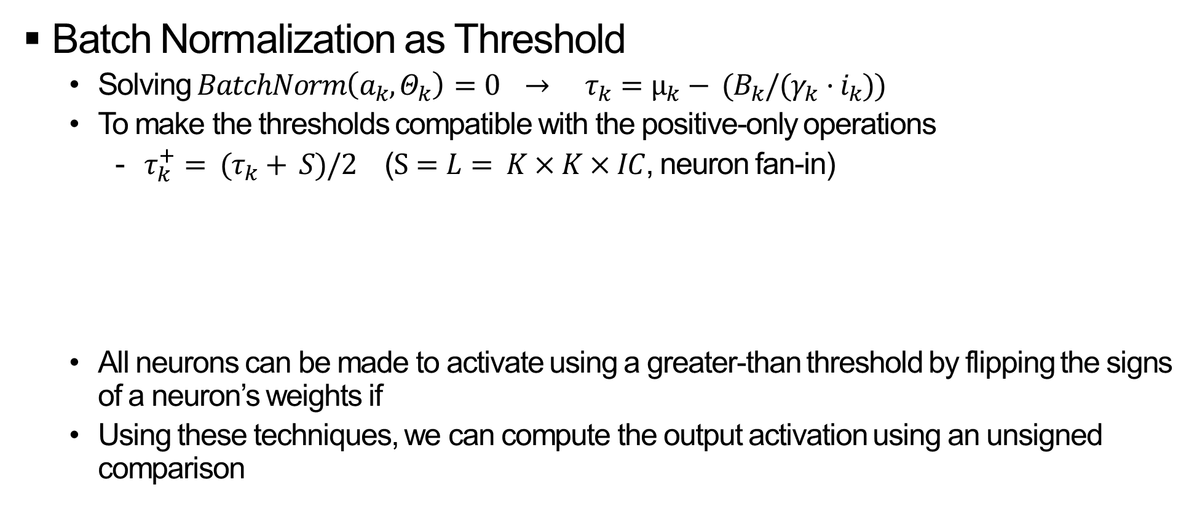
O3BNN-R
Batch Normalization as Threshold
Solving $BatchNorm\left(a_{k}, Θ_{k}\right)=0 → τ_{k}=µ_{k}− (B_{k}/(γ_{k}·i_{k}))$
To make the thresholds compatible with the positive-only operations
$τ_{k}^{+}= (τ_{k}+ S)/2$ ($S=L= K×K×IC$, neuron fan-in)
All neurons can be made to activate using a greater-than threshold by flipping the signs of a neuron’s weights if
Using these techniques, we can compute the output activation using an unsigned comparison

Slide 7
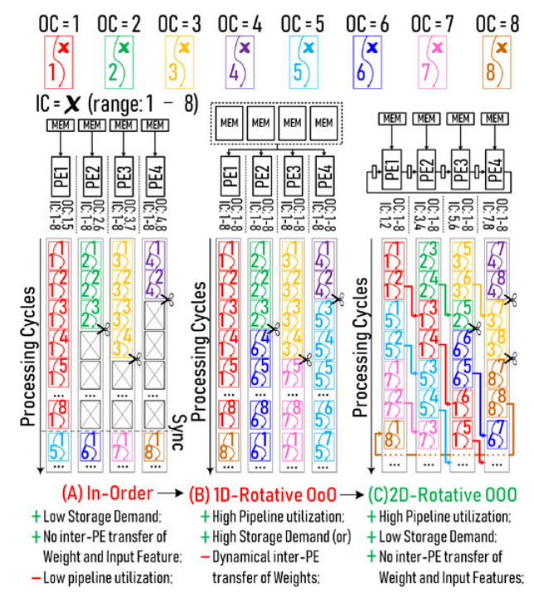
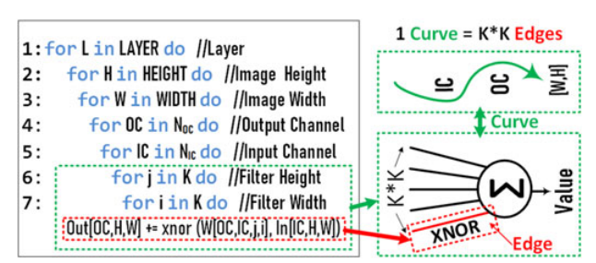
O3BNN-R
Parallelization Strategy & Workload Scheduling
Assume that 4 processing elements (PEs) process a BNN layer with 8 input and 8 output channels (IC=8, OC=8)
O3BNN : K (Loop 6-7), OC (Loop 4)
Our Work : K (Loop 6-7), IC (Loop 5)

Slide 8
O3BNN vs Our Work
Result
 | Alpha | First Layer Input Channel | Accuracy | Pruning Rate | BIT1 | BIT0
O3BNN | - | - | 88.5% | 27% | 18.5% | 8.5%
Our Work | 128 | 128 | 89.54% | 17.47% | 16.81% | 0.66%
Our Work | 8 | 128 | 89.54% | 22.24% | 20.68% | 1.56%
Our Work | 8 | 8 | 89.54% | 25.16% | 23.3% | 1.86%

Slide 9
O3BNN vs Our Work

Slide 10
O3BNN vs Our Work
Original ConvNet
Accuracy Loss : 0.49% (89.54% → 88.95%)
Block | Pooling window | Cycle count (Conv.) | Cycle count (Prop.) | Reduction rate (%) | Cycle count (No Skipping) | Cycle count (Prop.) | Reduction rate (%)
1 |  | 3264752 | 3263660 | 0.033448 | 3538944 | 3263660 | 7.778705
2 | (3/4) | 13038550 | 10730519 | 17.70159 | 18874368 | 10730519 | 43.14766
3 |  | 8079682 | 8060135 | 0.241928 | 9437184 | 8060135 | 14.59174
4 | (3/4) | 12030533 | 10659769 | 11.39404 | 18874368 | 10659769 | 43.52251
5 |  | 7458752 | 7441183 | 0.235549 | 9437184 | 7441183 | 21.15039
6 | (3/4) | 10566166 | 9162248 | 13.28692 | 18874368 | 9162248 | 51.45666
7 |  | 1032701 | 1029562 | 0.30396 | 1048576 | 1029562 | 1.813316
8 |  | 122506 | 119522 | 2.435799 | 131072 | 119522 | 8.811951
9 |  | 1280 | 1280 | 0 | 1280 | 1280 | 0
Total |  | 55594922 | 50467878 | 9.222144 | 80217344 | 50467878 | 37.08608

